Slide 1
DIGITAL PORTFOLIO
STUDENT NAME: Sakthi
REGISTER NO AND NMID:222409699&92D9C8A5902C92EB96A4B77BF86B3933
COURSE: BSc Computer Science
COLLEGE: Government Arts and Science College Perumbakkam, Chennai

Slide 2
PROJECT TITLE
STUDENT DIGITAL PORTFOLIO USING FRONT-END DEVELOPMENT

Slide 3
AGENDA
1. Problem Statement
2. Project Overview
3. End Users
4. Tools and Technologies
5. Portfolio design and Layout
6. Features and Functionality
7. Results and Screenshots
8. Conclusion

Slide 4
PROBLEM STATEMENT
A good portfolio project problem statement identifies a specific user, their unmet need, and the desired outcome, often framing it as a gap between the current and ideal state.
For a UX portfolio, it should include user insights, business metrics, and a specific product flow.
Urban Company users who book custom haircuts need to avoid confusion about stylist skill levels so that they can trust the service and feel confident in their choice.

Slide 5
PROJECT OVERVIEW
Project designed to demonstrate the use of HTML, CSS, and JavaScript in building visually appealing digital landscapes.
The Portfolio Overview allows you to quickly analyze and compare the key metrics of all the projects in the same workspace.
The metrics are calculated automatically from your project data and you can assign a corresponding color to each project, thus marking its overall status.

Slide 6
WHO ARE THE END USERS?
UX designer’s portfolio showcasing a new app for iPhone users, or a writer’s portfolio demonstrating content for busy professionals.
A graphic designer’s portfolio showing designs for a grocery shopper’s loyalty card, or a software developer’s portfolio featuring a web application used by millions of people.

Slide 7
TOOLS AND TECHNIQUES
PPM software (e.g., Oracle Primavera), financial calculators (e.g., for the Sharpe Ratio), and visual tools (e.g., BCG Matrix).
These are the software, frameworks, and other resources that support the techniques.
Portfolio management involves using techniques like portfolio scoring, scenario analysis, and resource optimization.

Slide 8
FEATURES AND FUNCTIONALITY
Portfolio presentations showcase work through features like project descriptions, visual elements, skill highlights, and testimonials.
Personal branding, attracting clients, and demonstrating expertise.
Many templates exist, such as formal, minimalist, or theme-specific designs found on platforms like Design Shack and SlideBazaar, to help create these portfolios.

Slide 9
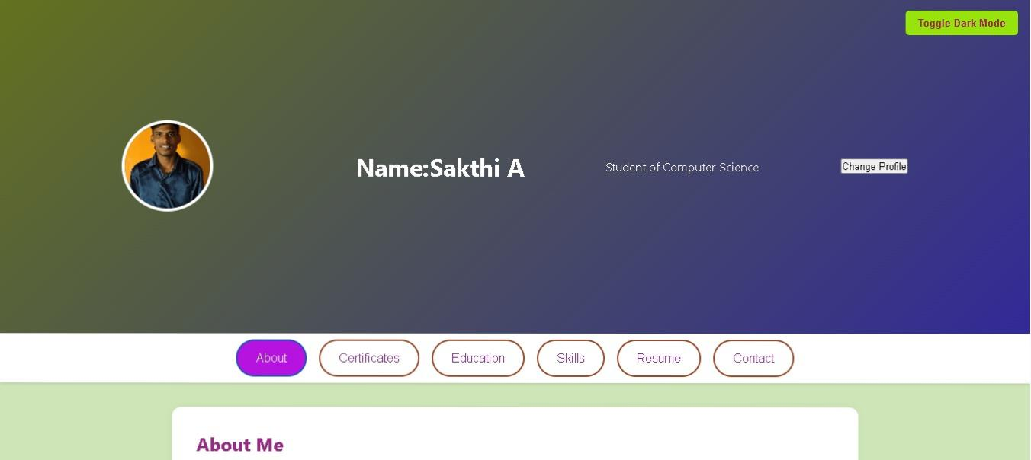
RESULT & SCREENSHOT
Result & Screenshot placeholder.

Slide 10
THE CONCLUSION
The Scenery Project successfully demonstrates how HTML, CSS, and JavaScript can be combined to create an interactive and visually appealing web page.
By designing natural elements like the sun, mountains, clouds, trees, and rivers, the project highlights both technical skills and creativity.
CSS animations and JavaScript functionalities bring life to the scenery, making it engaging for users.

